Slide 1
Construction material:Stones
Presentation by,
Hitesh Ganatra
Dept:Mechanical
Sub: Elements of civil engineering
Sub code:2110004
Roll no:209
Enroll no:131080119012
Amiraj College of Engineering & Technology

Slide 2
Contents
Introduction of stones
Requirements of stones
Types of stone
Uses of stones
Properties of stones
Test
Importance of stones

Slide 3
Introduction of stones
Stones are obtained from naturally occurring rocks.
By blasting of rocks the stones are obtained in the form of blocks , slabs and broken pieces.
Shaping and dressing of stones are essential to use them as building construction materials.
Example:-Basalt,trap,chalk,granite,kankar,limestone,marble,sandstone,slate.

Slide 4
Requirements of stone
1)Structure:- They may be crystalline or amorphous . Unstratified rocks are good as building stones.
2)Appearance- Colour Texture:-stones of light shades may be preferred to dark coloured stones.
3)Weight:-Light weight stones are preferred for domes and arches .A heavy stones is compact with very little porosity which contributes to structural stability.

Slide 5
4)Fineness of Grains:-For molding and carving works fine grained stones are very suitable
5)Durability:-Stones must have the property to resist loads, chemical action of atmosphere,rain,water,snow etc
6)Strength:-A stone for building work should have minimum 100 to 350 N/mm*mm crushing strength.
Igneous rocks have 100 to 350 N/mm*mm crushing strength
Sedimentary rocks have low crushing strength

Slide 6
7)Hardness:-Stones should have good resistance against wear and tear.
8)facility of working and dressing:-Stones for buildings must be such that they can be cut to required size.

Slide 7
Types of Stones
Geological, formation.
Stratified,
Un-stratified,
Foliated
Chemical composition
Siliceous,
Argillaceous,
Calcarious
Structure
Igneous,
Sedimentary,
Metamorphic

Slide 8
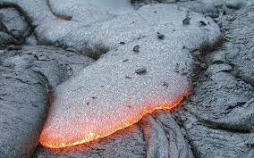
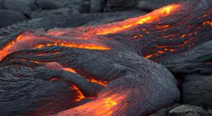
Geological formation
1)Igneous rocks

Slide 9
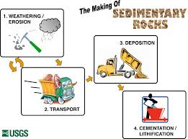
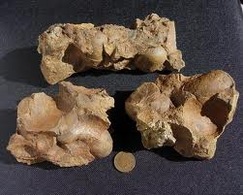
2)Sedimentary rocks

Slide 10
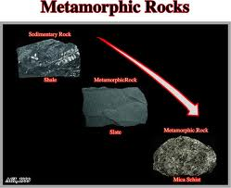
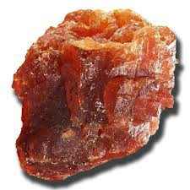
3)Metamorphic rocks

Slide 11
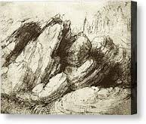
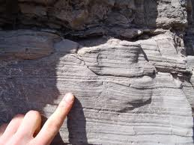
General structure
1)Stratified

Slide 12
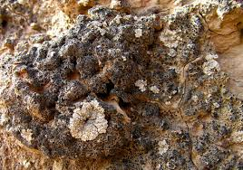
2)Unstratified

Slide 13
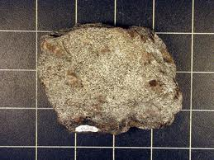
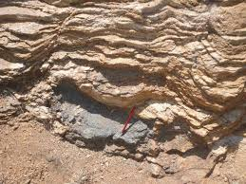
3)Foliated

Slide 14
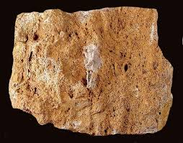
Chemical composition
1)Siliceous

Slide 15
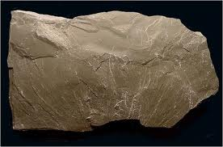
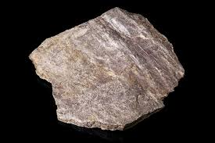
2)Argillaceous

Slide 16
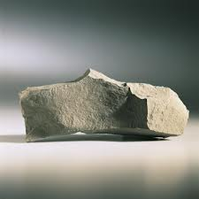
3)Calcareous

Slide 17
Uses of stones
1)They are used in foundation,walls,columns,arches,cornices,bed blocks etc.
2)They are used in ornamental features and to provide fine smooth faces of walls.
3)They are used in hydraulic structures like dams and bridges.
4)They are used in retaining wall masonry to retain soil.

Slide 18
Uses(Continue)
5)They are used as road metal in road construction.
6)They are used as ballast for permanent way in railways.
7)They are used to make concrete in the form of coarse aggregate.

Slide 19
Properties of stones
1)Siliceous rocks are hard and durable.they are not easily affected by weathering actions.
2)Argillaceous rocks may be dense and compact or they may be soft.
3)The durability of calcareous rocks will depend upon the constituents present in surrounding atmosphere.
4)Marble and quartzite have compact crystalline structure.
5)Sandstone and gneiss have granular crystalline structure .crystals are of similar size.

Slide 20
6)igneous rocks contain many minerals. various minerals having wind range of different distinctive characteristics.

Slide 21
Tests
1)acid test-resistance to acids and chemicals.
2)attrition test-rate of wear of stones.
3)crushing test-compressive strength
4)crystallization-structure
5)freezing and thawing test-effect of wind , sun rays, rain etc.
6)hardness test-to determine hardness
7)Impact test-To determine toughness

Slide 22
8)Microscopic test- Grainsize , texture , mineral constitutions,existence of pores,fissures,veins and shakes.
9)Smith’s test-For presence of soluble matter

Slide 23
Importance of stones
Stones should be placed in walls with the direction of their natural beds as horizontal
In stone masonry , the direction of natural bed of all sedimentary stones should be perpendicular to the direction of pressure such an arrangement gives maximum strength to stonework

Slide 24
Use in Construction
Name | Type | Use
Granite | Igneous | Steps, Facing walls, Floors, Kitchen Platform
Basalt | Igneous | Foundation, Road metal, Ingredient of concrete
Gneiss | Metamorphic | Rough Masonry
Laterite | Metamorphic | masonry
Marble | Metamorphic | Ornamental work, facing wall, kitchen platform
Slate | Metamorphic | Roofs & sills
Limestone | Sedimentary | Footing, Paving & Flooring
Sandstone | Sedimentary | Facing wall, floors, walls, ornamental works

Slide 25


